Slide 1
JOHN 15:12-13 May 8, 2019
Notes:
Next Slide

Slide 2
“This is my commandment.”

Slide 3
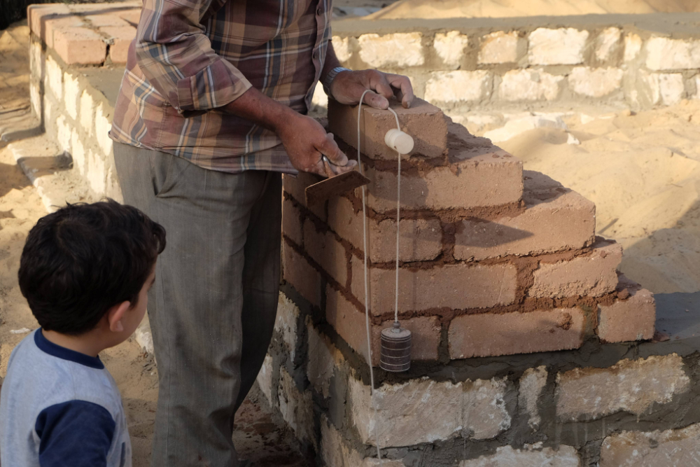

Slide 4
A plumb line is a weight suspended from a string used as a vertical reference line to ensure a structure is centered.

Slide 5
RE TEXT: I COR. 13:1-3
“Paul shows the necessity of love to make the employment of spiritual gifts constructive.”
The Moody Bible Commentary on I Corinthians 13:1-3

Slide 6
The greatest of our gifts are rendered ineffective, if they are not exercised in love!

Slide 7
Romans 5:8
But God commendeth his love toward us, in that, while we were yet sinners, Christ died for us.

