Slide 1
JOHN 15:16 May 22, 2019
Notes:
Next Slide

Slide 2
“This is my commandment.”

Slide 4
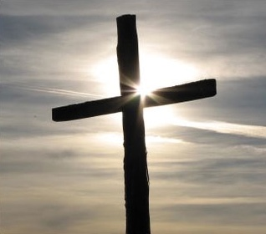
A plumb line is a weight suspended from a string used as a vertical reference line to ensure a structure is centered.

Slide 5
“I made God my choice!”

Slide 6
Those, whom He chooses, He also ordains/anoints/empowers, to do His will!
II Corinthians 4:7
I Corinthians 1:26-28
I Corinthians 1:29

Slide 7
Those, whom He chooses, He also ordains/anoints/empowers, to do His will!
II Corinthians 4:7
I Corinthians 1:26-28
I Corinthians 1:29

