Slide 1
JOHN 15:1-3 April 3, 2019
Notes:
Next Slide

Slide 2
The Relation of the Believers to Jesus
15:1-11
The Relation of Believers to Each Other
15:12-17
The Relation of Believers to the World
15:18-27

Slide 3
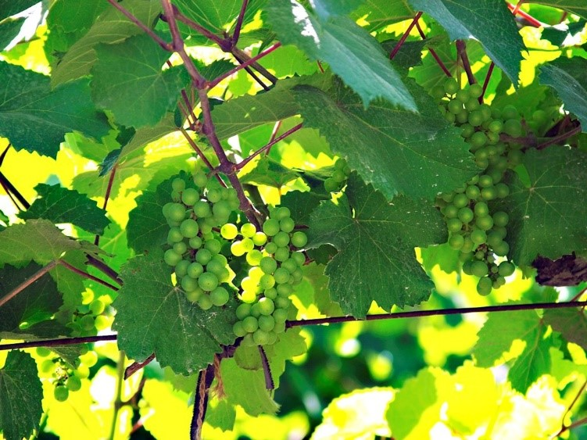

Slide 4
“The True Vine”
The Authentic
The Beginning
The Source
The Original

Slide 5
“God gave, or appointed his Son to be, the source of blessings to man; that all grace descends through him; and that God takes care of all the branches of this vine - that is, of all who are by faith united to the Lord Jesus Christ. In Jesus and all his church he feels the deepest interest, and it is an object of great solicitude that his church should receive these blessings and bear much fruit.”

Slide 6
Pruning!

Slide 7
Those, who profess Christianity, yet, have no evidence (fruit) of a true relationship with Christ.

Slide 8
The true Believer, whose relationship to Christ is evident by the fruit they produce.
Matthew 13:23
But he that received seed into the good ground is he that heareth the word, and understandeth it; which also beareth fruit, and bringeth forth, some an hundredfold, some sixty, some thirty.

Slide 9
Chastises us for the sin that hinders us.
Removes people from our lives that hinder our spiritual growth.
Removes us from situations that hinder our spiritual growth.
Allows trials in our life to strengthen our faith.
Often, these are painful processes!

