Slide 1
Basics of Understanding the Bible
COURSE 1/Class 4: Duties of Reader
Williams Grove Baptist Church
Instructor: Reverend Kirby Jones
Email: Pastorkirbyj@gmail.com

Slide 5
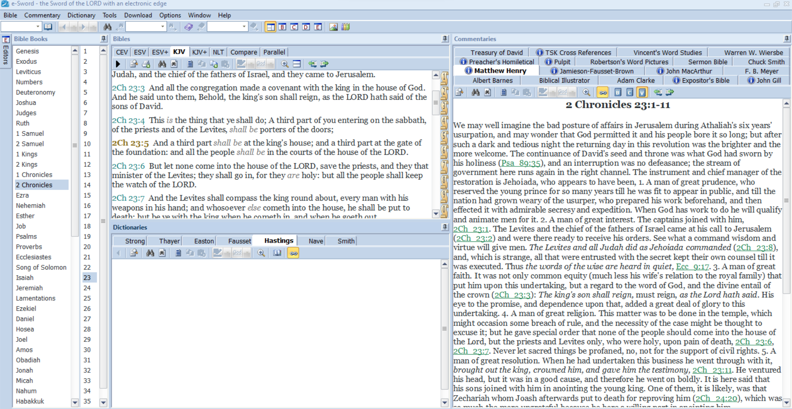

Slide 6
Basics of Understanding the Bible
COURSE 1/Class 4: Duties of Reader
Williams Grove Baptist Church
Instructor: Reverend Kirby Jones
Email: Pastorkirbyj@gmail.com

