Slide 1
JOHN 17:7-8 November 13, 2019
Notes:
Next Slide

Slide 2
“They”
The 11 Disciples
“Thou”
The Father
“Me”
Christ
“Thee”
The Father

Slide 3
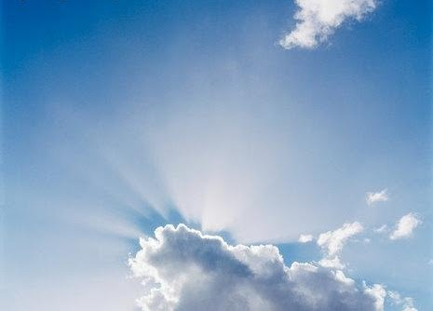
Source
Agency
Cause

Slide 4
What Was The Source
Of His Power?

Slide 5
It’s not about the miracle.
It’s about the source of the miracle!

Slide 6
John 17:8
For I have given unto them the words which thou gavest me; and they have received them, and have known surely that I came out from thee, and they have believed that thou didst send me.

Slide 7
John 17:8
For I have given unto them the words which thou gavest me; and they have received them, and have known surely that I came out from thee, and they have believed that thou didst send me.

Slide 8
John 17:8
For I have given unto them the words which thou gavest me; and they have received them, and have known surely that I came out from thee, and they have believed that thou didst send me.

Slide 9
The disciples took hold/embraced all the teachings and doctrines of Christ; and they were absolutely and resolutely sure that Jesus was who He said He was; and they demonstrated their resolve by placing their faith and trust in Him.

