Slide 1
JOHN 16:24-25 September 4, 2019
Notes:
Next Slide

Slide 2
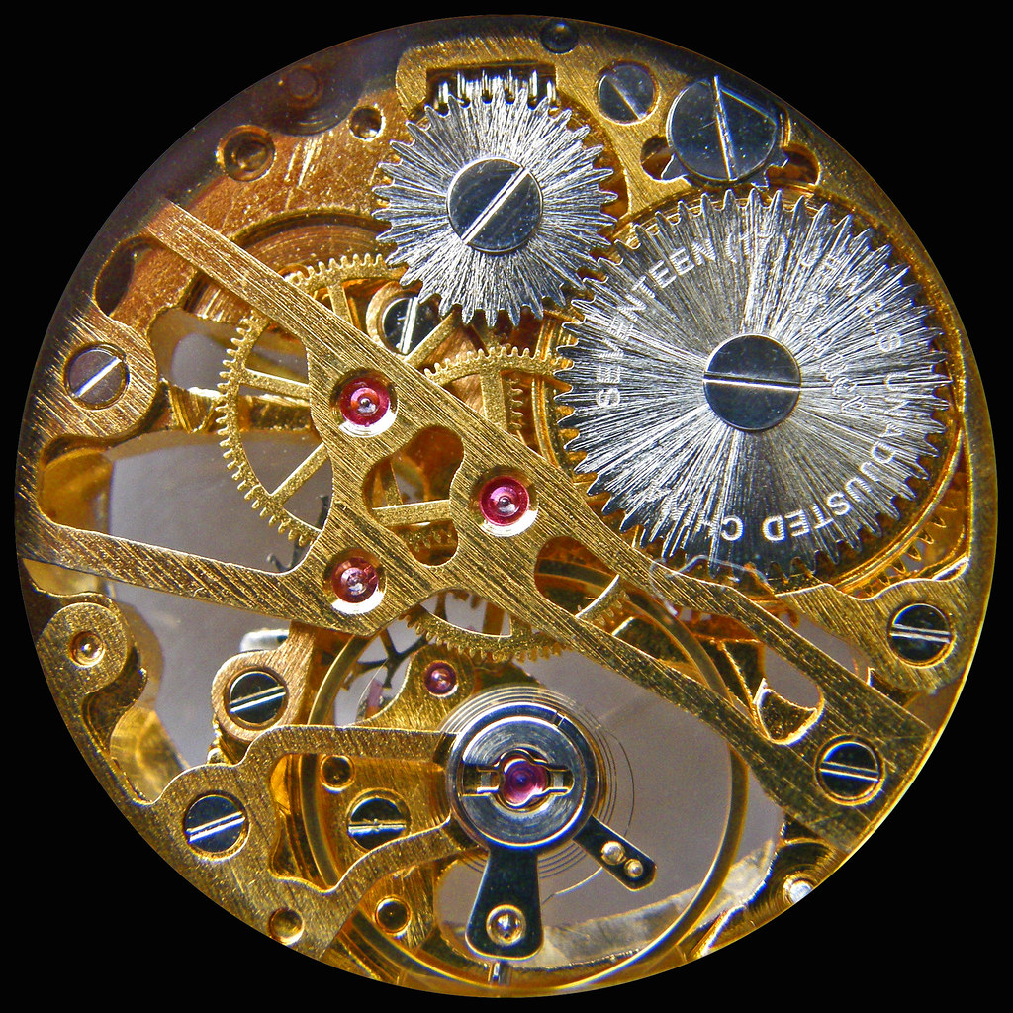

Slide 3
They have never prayed to the Father in His name.

Slide 4
Matthew 7:22-23 Many will say to me in that day, Lord, Lord, have we not prophesied in thy name? and in thy name have cast out devils? and in thy name done many wonderful works?
And then will I profess unto them, I never knew you: depart from me, ye that work iniquity.

Slide 5
There is nothing we will ever need in order to obey God, to serve God, or to carry out God’s will for our lives, of which He will not provide!

Slide 6
Obeying God, Serving God, And Doing God’s Will Is Not Supposed To Be A Burdensome Hardship, In Life!

Slide 7
Mansions
Vines
Branches
A Woman’s Travail

Slide 8
The limitations of human language.
The limitations of the natural man to understand spiritual realities.

Slide 9
1 Corinthians 13:12 (NLT) Now we see things imperfectly, like puzzling reflections in a mirror, but then we will see everything with perfect clarity. All that I know now is partial and incomplete, but then I will know everything completely, just as God now knows me completely.

