Slide 1
JOHN 17:16-17 December 18, 2019
Notes:
Next Slide

Slide 2
John 17:16 “They are not of the world, even as I am not of the world.”

Slide 3
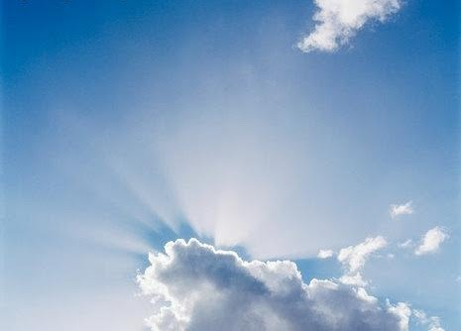
The Incarnation

Slide 4
1 John 2:16

Slide 5
“There will come a day, when you will have as much
money as
Bill Gates!”

Slide 6
We ARE Sanctified
We are BEING Sanctified
We SHALL BE Sanctified

Slide 7
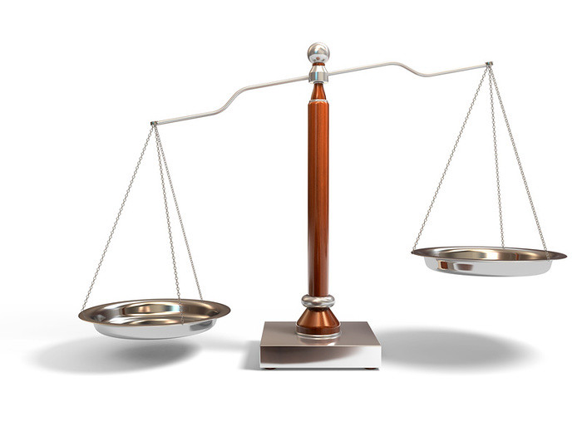
Truth!

Slide 8
The knowledge of truth begins with the revelation of the Gospel of Jesus Christ; and from there, reaches into every aspect of our life, whereby we begin to view and understand all things pertaining to life, with the mind of Christ.

Slide 9
The Logos of God – all that He has uttered and decreed.

