Slide 1
JOHN 17:4 October 30, 2019
Notes:
Next Slide

Slide 2
His preaching brought glory to God
By declaring his mission was from God
By obedience to the will of God

Slide 3
By healing the sick, feeding the hungry, and relieving the suffering
By the demonstration of grace, mercy, and the forgiveness of sins
By the sinless life He led

Slide 4
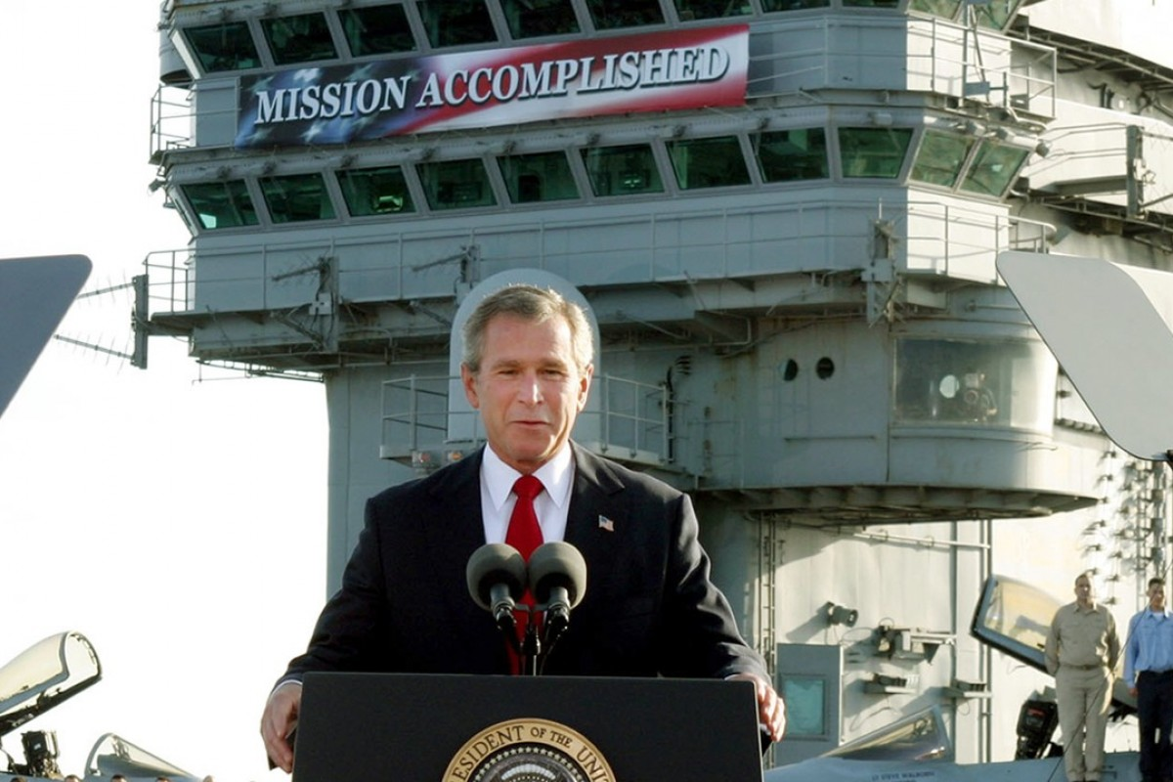

Slide 5
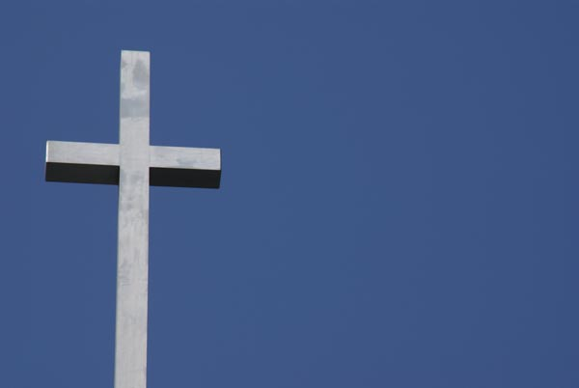
Mission
Accomplished!

Slide 6
Am I Doing The Work
God Sent Me To Do?

Slide 7
Our past: failures – disappointments – sins
2. Our future: we are running out-of-time

Slide 8
Psalm 51:11-13
Joshua 14:10-12
It’s not how you start.
It’s how you finish!

Slide 9
Now, Christ is praying that the Father return to Him, His full measure of glory – that which was His eternal, divine glory, before the foundation of the world – a glory equal to the Fathers!

Slide 10
I John 3:2
“The glorious nature of that conformity defies description, but as much as glorified humanity can be like incarnate deity, believers will be…”
- John McArthur

