Slide 1
JOHN 17:13-15 December 11, 2019
Notes:
Next Slide

Slide 2
“And now come I to thee; and these things I speak in the world...”

Slide 3
The Revealing Of The Gospel
The Demonstration Of His Power
The Oneness Of He And The Father
The Work Of Redemption
The Giving Of Salvation And Eternal Life
And The List Goes On And On…

Slide 4
Romans 8:3 (NLT) The law of Moses was unable to save us because of the weakness of our sinful nature. So God did what the law could not do. He sent His own Son in a body like the bodies we sinners have. And in that body God declared an end to sin's control over us by giving His Son as a sacrifice for our sins.

Slide 5
They followed the teachings of a “false teacher” and a “blasphemer.”
They were uneducated, unsophisticated, Galileans.
They approved of things that were contrary to Jewish tradition.
Their activities could stir the wrath of Rome.

Slide 6
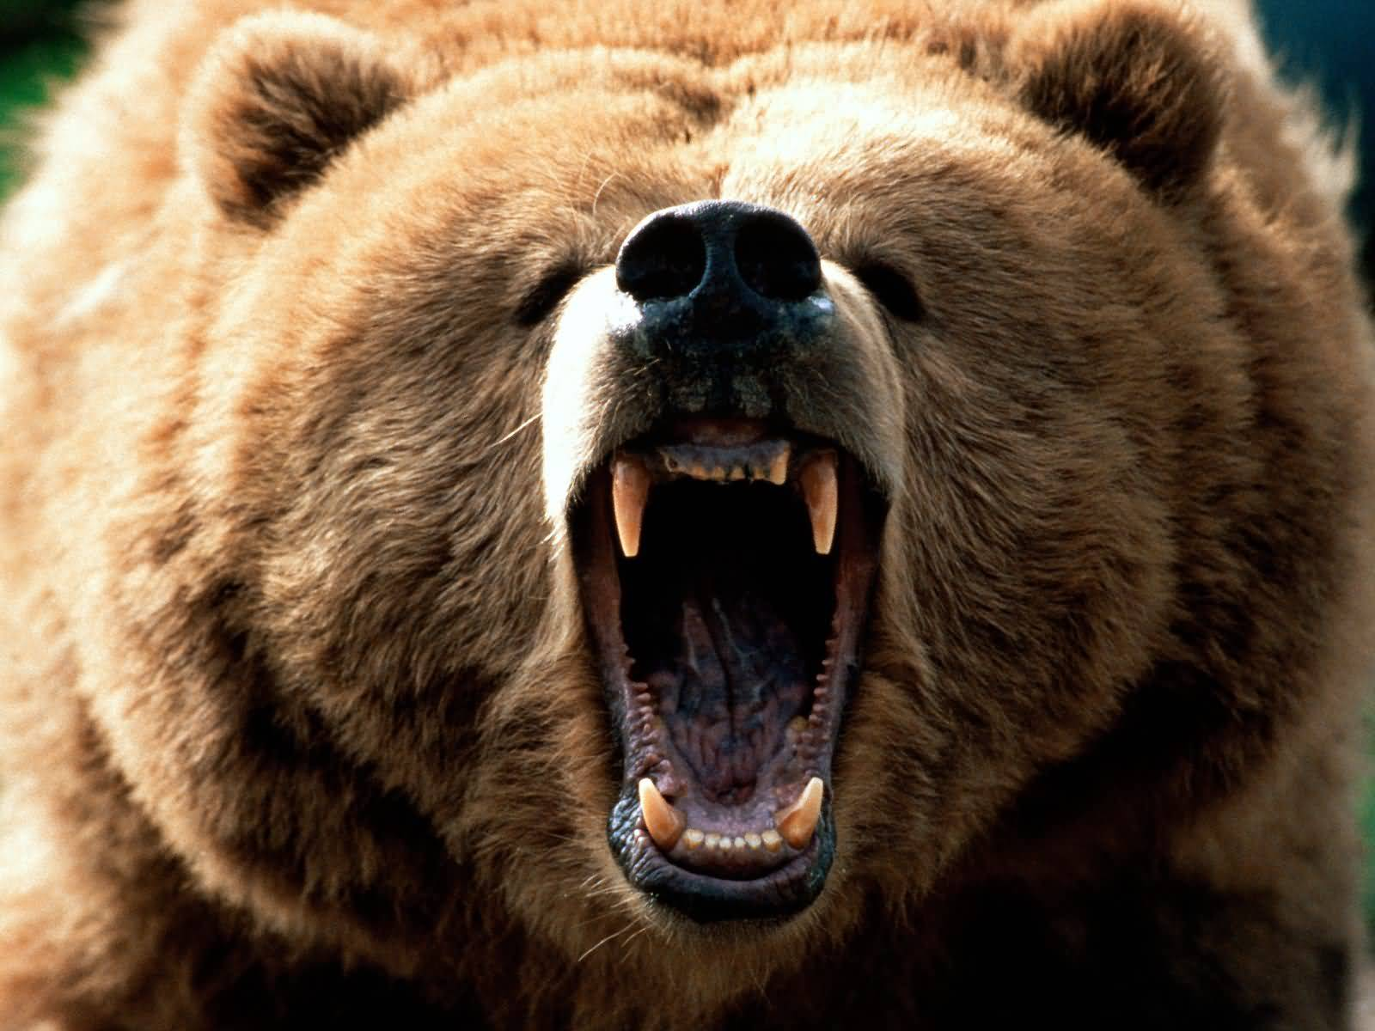

Slide 7
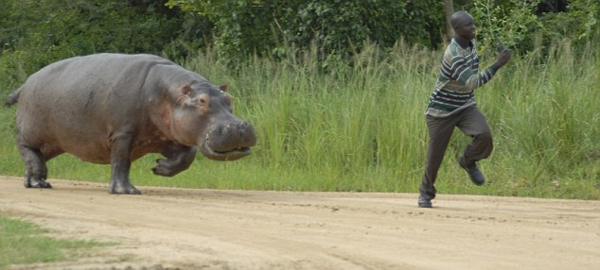

Slide 8
“Keep them from the evil”

Slide 9
Apostasy (turning back)
Being overtaken by the ways of the world
Being overtaken by sin’s temptations
The plots and plans of Satan
From discouragement in trials

