Slide 1
JOHN 16:13 July 24, 2019
Notes:
Next Slide

Slide 2
Seeks to prove conclusively that Jesus is the Son of God
Presents the Person and the work of the Holy Spirit

Slide 3
“Howbeit when he, the Spirit of truth, is come.”

Slide 4
Eternality – Hebrews 9:14
Omnipresence – Psalm 139:7-10
Omniscience – I Corinthians 2:10-11
Omnipotence – Luke 1:35
Creator – Job 33:4
Deity - Acts 5:3-4

Slide 5
“The creation, revelation, transmission, preservation, and application of that truth is made possible by the living personal Spirit who comes to each one of the disciples.”
Tenney, Merrill C. John: The Gospel of Belief. Grand Rapids: Wm. B. Eerdmans, 1976 (page 238).

Slide 6
All Things Pertaining To The Knowledge Of God
Everything That Is Profitable/Beneficial To Life
All Things That Pertain To True Worship And Holy Living
Understanding Of The Doctrines Of Scripture
The Ability To Recognize And Shun That, Which Is False

Slide 7
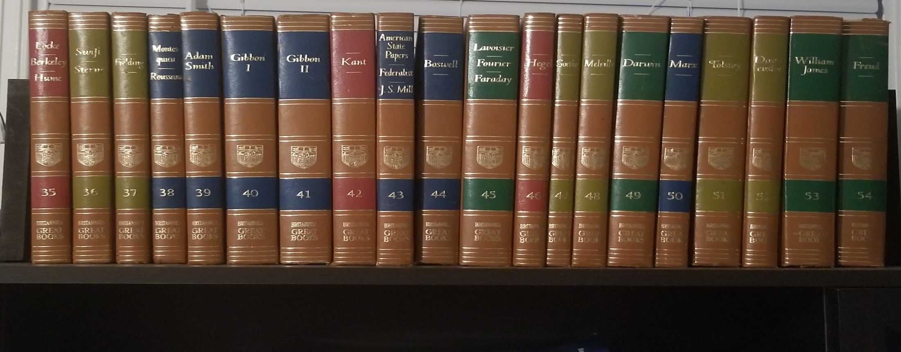
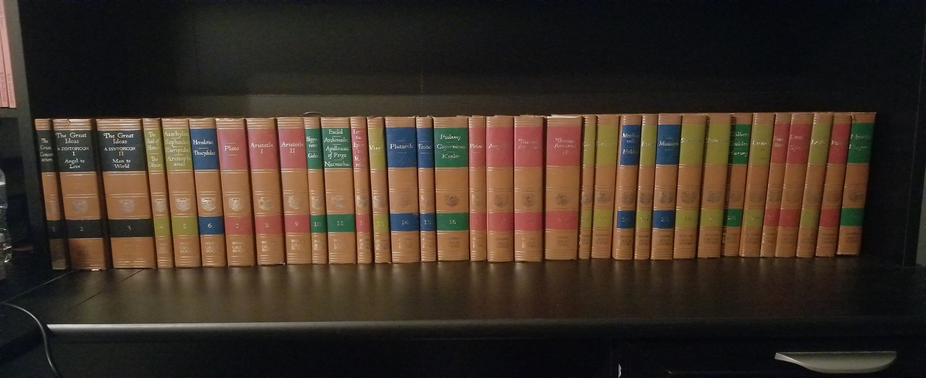

Slide 9
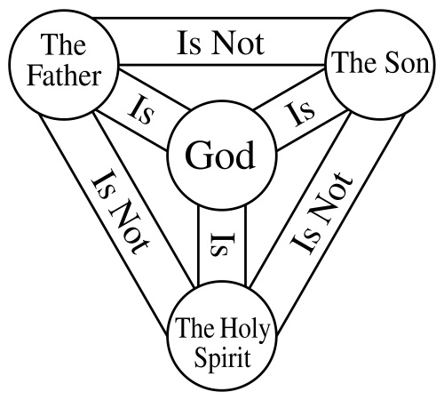

Slide 10
“Jesus never said that.”

