Slide 1
Basics of Understanding the Bible
COURSE 1: Duties of Reader
Williams Grove Baptist Church
Instructor: Reverend Kirby Jones
Email: Pastorkirbyj@gmail.com

Slide 2
If not grounded in God’s Word, Churches will pursue other things and “themes” to attract people (often unconverted people) and keep them coming back.
Emotional/Sentimental Gospel
Psychological/Therapy Gospel
Black Liberation Political Gospel
White Nationalism Political Gospel
Social Gospel
Entertainment Gospel
Miracles, Signs, and Wonders Gospel
Prosperity Gospel

Slide 3
C
O
U
R
S
E
O
B
J
E
C
T
I
V
E
S
Know what the Bible says concerning its Authority.
Discover the methods necessary to understand Scripture (Bible interpretation): to ascertain the author’s original intent.
Gain a knowledge of the various audiences, to which Scripture was written, and use that knowledge in understanding a passage.
Recognize the challenges of accurate interpretation, such as distance of time, differences in culture, variances in geography, etc.

Slide 4
“Hermeneutics is a system of restrictions that examines the context, grammar, geography, cultural background, and literary genre (varieties) of Scripture, so that the Bible reader can determine the original author’s literal and intended meaning.”

Slide 5
Nehemiah 8:8

Slide 6
What Does The Bible
Say About Itself?
Zechariah 7:12
Matthew 5:17
2 Timothy 3:16, 17
2 Peter 1:20, 21
2 Peter 3:16

Slide 7
Prophecy Fulfilled
Over 300 Old Testament references to the Messiah that were fulfilled in Jesus of Nazareth.
Born of a Woman - Genesis 3:15
Born of a Virgin - Isaiah 7:14
Seed of Abraham - Genesis 22:18
Tribe of Judah - Genesis 49:10
House of David - Jeremiah 23:5)
Born in Bethlehem - Micah 5:2
Smitten and Spat on - Isaiah 50:6
Numbered among Transgressors - Isaiah 53:12
Buried by the Rich - Isaiah 53:9

Slide 8
Indestructible In Nature
Survival Through Time
Survival Through Persecution
Survival Through Criticism

Slide 9
Changed Lives
The Bible has demonstrated it is the Word of God, by the countless lives it has transformed by the power of God working through its message. Holy writ has changed the most vile, wicked, sinful of human beings into the holiest, most loving, and self-giving of people.

Slide 10
The Holy Spirit works in us to make us more honest as we interpret Scripture, especially with those parts that are contrary to our sinful nature, such as…
Fear
Compromise
Personal Preferences and prejudices
Church Tradition
Etc.

Slide 11
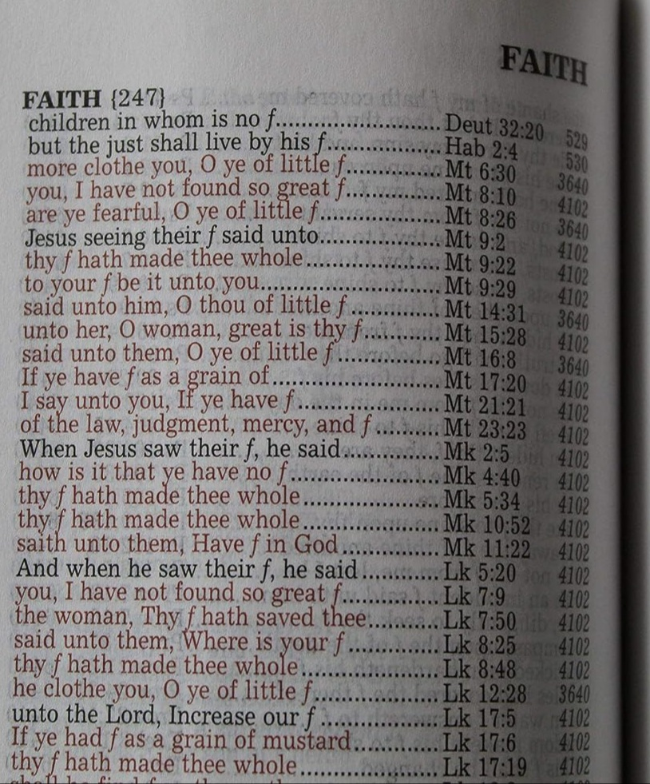

Slide 12
Joh 21:15 So^{G3767} when^{G3753} they had dined,^{G709} Jesus^{G2424} saith^{G3004} to Simon^{G4613} Peter,^{G4074} Simon,^{G4613} son of Jonas,^{G2495} lovest^{G25} thou me^{G3165} more^{G4119} than these? He^{G5130} saith^{G3004} unto him,^{G846} Yea,^{G3483} Lord;^{G2962} thou^{G4771} knowest^{G1492} that^{G3754} I love^{G5368} thee.^{G4571} He saith^{G3004} unto him,^{G846} Feed^{G1006} my^{G3450} lambs.^{G721}
Joh 21:16 He saith^{G3004} to him^{G846} again^{G3825} the second time,^{G1208} Simon,^{G4613} son of Jonas,^{G2495} lovest^{G25} thou me? He^{G3165} saith^{G3004} unto him,^{G846} Yea,^{G3483} Lord;^{G2962} thou^{G4771} knowest^{G1492} that^{G3754} I love^{G5368} thee.^{G4571} He saith^{G3004} unto him,^{G846} Feed^{G4165} my^{G3450} sheep.^{G4263}
Joh 21:17 He saith^{G3004} unto him^{G846} the^{G3588} third time,^{G5154} Simon,^{G4613} son of Jonas,^{G2495} lovest^{G5368} thou me?^{G3165} Peter^{G4074} was grieved^{G3076} because^{G3754} he said^{G2036} unto him^{G846} the^{G3588} third time,^{G5154} Lovest^{G5368} thou me?^{G3165} And^{G2532} he said^{G2036} unto him,^{G846} Lord,^{G2962} thou^{G4771} knowest^{G1492} all things;^{G3956} thou^{G4771} knowest^{G1097} that^{G3754} I love^{G5368} thee.^{G4571} Jesus^{G2424} saith^{G3004} unto him,^{G846} Feed^{G1006} my^{G3450} sheep.^{G4263}

Slide 13
Koine Greek Words For “Love”
Eros: physical/erotic love
Storge: family love
Philia: brotherly/friendship love
Agape: divine/self-sacrificial love/unconditional

