Slide 1
JOHN 15:4-5 April 10, 2019
Notes:
Next Slide

Slide 2
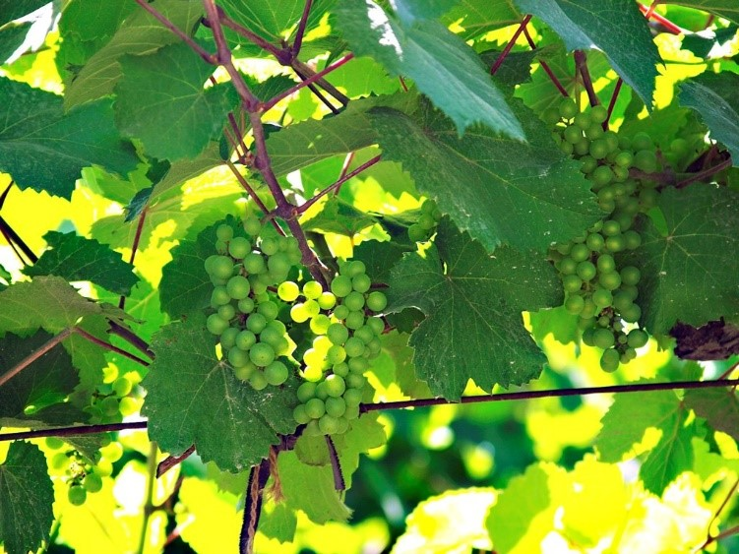

Slide 3
The true believer.
The false, apostate, who is connected to the church, but not to the Vine.

Slide 4
“The maintenance of an unbroken connection rather than repose, and bespeaks of the necessity of a constant relationship between the believer and his Lord, if the resultant life is to be productive.”
- Tenney

Slide 5
How do I “abide” in Christ?

Slide 6
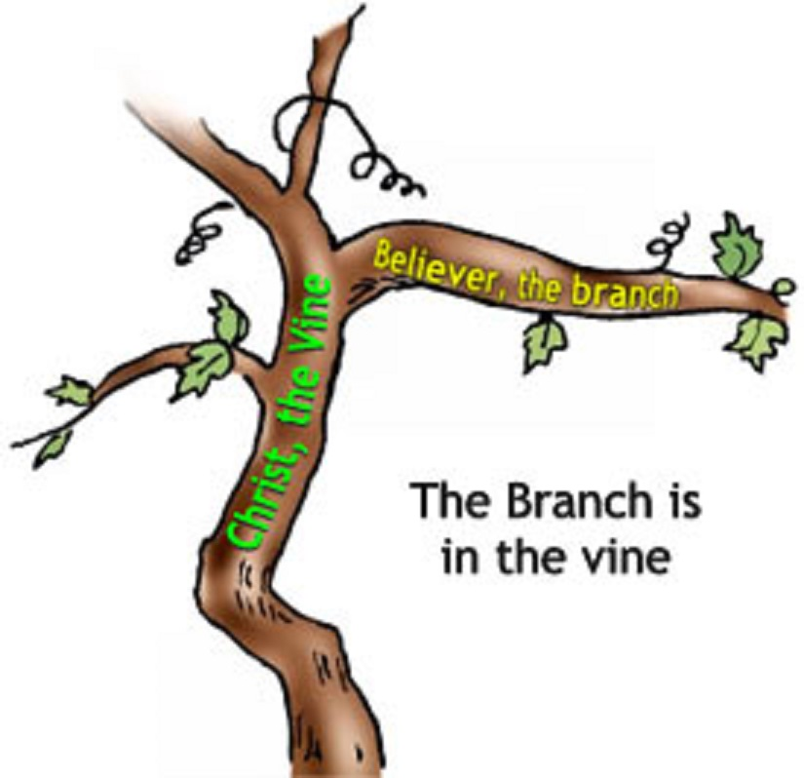

Slide 7
“I am the vine, ye are the branches.”

Slide 8
Galatians 5:22-23
But the fruit of the Spirit is love, joy, peace, longsuffering, gentleness, goodness, faith, Meekness, temperance: against such there is no law.

Slide 9
